Slide 1




AgriAdvisor
Machine Learning Based Crop and Fertilizer Recommendation for Sustainable Agriculture in
Sri Lanka
Web Based Crop and Fertilizer Recommendation Application
Presented By: MMA Prabuddhika
2025.11.25

Slide 2
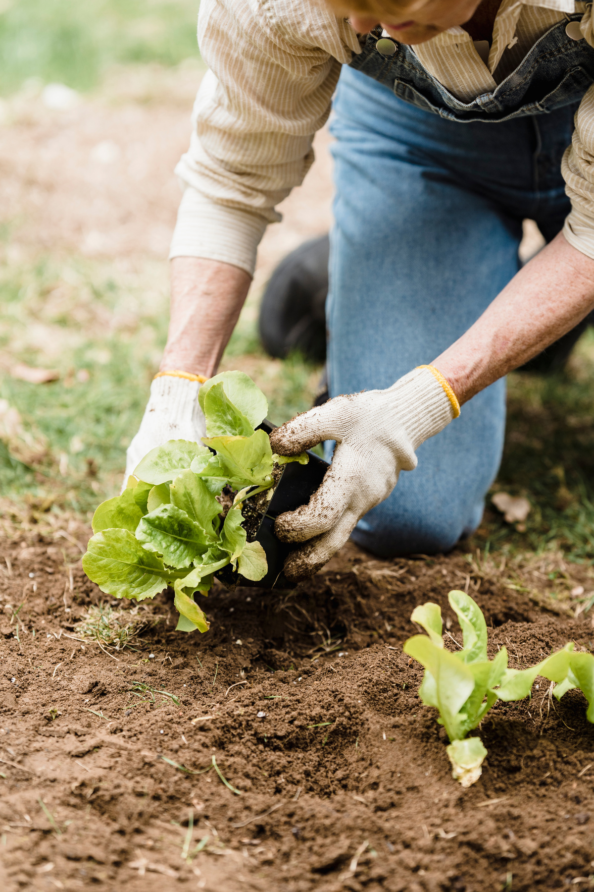
Table Of Content
Problem Identification
Objectives
Methodology
Key Findings
Novelty
Deployment and Evaluation

Slide 3


Problem Statement
Many Sri Lankan farmers rely on traditional practices and personal experience when choosing crops and fertilizers. This often leads to
poor yields
soil damage
inefficient resource use.
There is a lack of accessible, data driven tools to guide agricultural decisions. This project addresses that gap by introducing a machine learning based recommendation system tailored to local conditions.

Slide 4





Objectives
01
02
03
04
To develop a machine learning based crop recommendation system that considers various environmental and soil parameters.
To design and implement a fertilizer recommendation model based on soil nutrients, crop type, and environmental factors.
To evaluate the performance of the machine learning models using appropriate evaluation metrics.
To integrate both crop and fertilizer recommendation models into a single user friendly web application

Slide 5












Methodology
Data Collection
Model
Training
Web Application Development
Problem
Identification
Data Preprocessing
Model Evaluation
Testing & Deployment

Slide 6



Key Findings
Accuracy
Preprocessing
The machine learning models for both crop and fertilizer recommendation showed high accuracy, with the crop model achieving over 90% accuracy.
Preprocessing techniques like label encoding and oversampling helped address imbalanced data effectively.
Integration
Impact
The hosted web based application integrated both models successfully, providing real-time, user-friendly predictions.
The system shows strong potential to support informed agricultural decisions, especially in data-scarce regions like Sri Lanka.

Slide 7

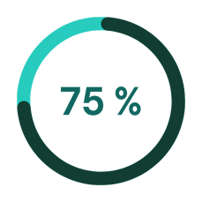
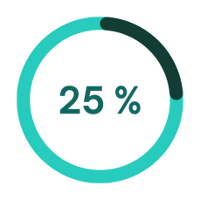



Novelty
Localized Focus
Designed specifically for Sri Lankan agriculture, adapting non-local datasets effectively.
Fully Deployed System
A complete ML-powered web application that is hosted and accessible online.
User-Friendly Design
Provides real-time, web-based recommendations with minimal input needed from the user.

Slide 8

AgriAdvisor
THANK TOU
For watching this presentation
https://agriadvisor.site

Slide 9

AgriAdvisor

